Slide 1

Viewtime Customization of Hyperdistributed Video Content
Matthew Bennett
University of Southern Mississippi
matthew.bennett@usm.edu

Slide 2





What is Hyperdistribution?
Term coined in 2005 by Mark Pesce.
Think BitTorrent
Thunderstorm analogy: many small raindrops make a torrential downpour
Hyperdistributed Client/Server

Slide 3
Briefly, BitTorrent
A .torrent file tells the BitTorrent client how to talk to the “tracker”
The tracker gives the client a current list of peers who are downloading the same files, as well as which pieces are available.

Slide 4
Briefly, BitTorrent
The client chooses which pieces to download from which hosts, and downloads many pieces in parallel.
Every downloading client is also an uploader its participating peers.
Some clients act as “seeders” or upload-only, after the file is finished downloading.

Slide 5
Popularity
Popularity increases availability.
Content is available before it is released via broadcast or in theaters.

Slide 6
Robustness
Popular BitTorrent clients are open source
Any time the system is attacked, the code is adapted to make that attack impossible.
  Example: Movement away from a central tracker to a Distributed Hash Table, where “The network is the data.”

Slide 7
Foothold
In 2004, 35% of all internet traffic was BitTorrent.
A conservative projection predicts 45% of internet traffic for Hyperdistributed Content by the end of 2006 (BitTorrent and others).

Slide 8
BitTorrent provides choice.
Watch anything, “near on demand”.
Watch on many devices: cameras, cell phones, PCs, laptops, video players, PDAs, iPod, handheld gaming platforms.
If you don’t enjoy it, delete it.
Inexpensive hard drives provide the ability to create huge personal media libraries.

Slide 9
Hyper is Here to Stay
Hyperdistribution can’t go away.
In addition to already being popular and robust, and offering incredible choice, hyperdistribution is extremely cheap.
Producers must adapt or die. Hyperdistribution has already gained a substantial foothold.

Slide 10
The Current TV Model
Television shows are broadcasted.
  Distribution is centralized from IP owners.
Advertising pays for production costs.
Viewers do not want to pay for content.
  And they actually don’t.
  Subtle distinction: choice vs content.

Slide 11
When the viewers control the distribution, they also pay for the distribution… but
What happens to the ads?

Slide 12
More Importantly
What happens to the ad revenue?

Slide 13
Ready for a new model?
Hyperdistribution is, with “bitCasting”
Can producers provide their content in while protecting their revenue? How?
  Protect the content somehow.
  Mandatory video customizations can then provide advertising revenue and allow for total content control.

Slide 14
Simple protection: encryption
Use a symmetric key to encrypt the video.
Hyperdistribute / bitCast protected content.
Use a proprietary codec to authorize, decrypt, and play back the content with necessary customizations.

Slide 15
Customization Problems
The Problem withStatic Advertising: Sponsors and Syndication
The “editing problem”
The “intrusion problem”
Man-in-the-middle attack / redirection attack
User-side Hacking **

Slide 16
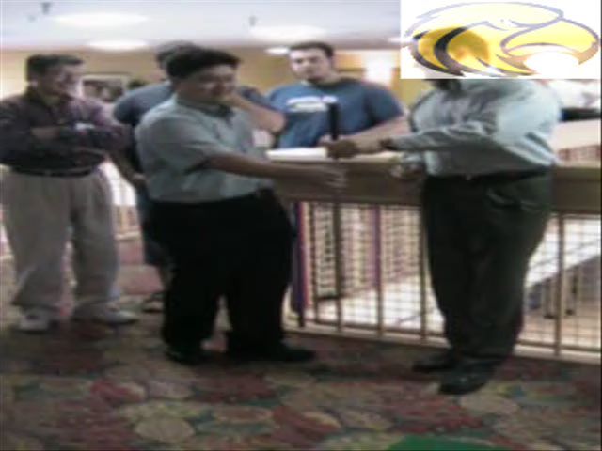
Overlay Customization

Slide 17
Algorithm for Viewing
Upon playing the base content
Find Agency (based upon the base content)
Get agency_public_key from a third party
If it custom content is out of date then
Send user_public_key
Get custom_content, pre-key
Vidkey = Verify ( Decrypt (pre-key, via User_public_key), via Agency_Public_Key)
If verification fails, reload cached custom_content and vid-key
For each frame in base_content
Display Overlay( custom_content[frame], Decrypt (base_content[frame], via vidkey) )

Slide 18
Not Just for Advertising
Added value content, including
  Interactive onscreen displays
  Audience participation, such as a forum
  Sports scores
  Current events
  Buy it now
  Hyperlinks!

Slide 19
Conclusion
Hyperdistribution is not going away.
Producers should adapt to new technologies.
Luckily, the transition is possible with viewtime customization.
Viewtime customization has other great uses.

Slide 20
References
Pesce, M. “Piracy Is Good?,” lecture, via bit torrent
Cohen, B. Incentives Build Robustness in BitTorrent.
Azureus BitTorrent client. http://azureus.sourceforge.net/
Jensen, J. Interactive Television
Nazareno, A. Mowbray, M. Lima, A. Wagner, G. Ripeanu, M. Freeriders: Influences on cooperation in BitTorrent communities.

Slide 21
Questions?
Matthew.bennett@usm.edu

